Slide 1
Shaurya’s Lens: Boston Crime
Analyzing Boston’s Crime data

Slide 2
10 Thousand foot view of Recorded Crime Incidents
~
4 year
Data
1307 Shootings
37k+ Vehicle
Accident Incidents
181k+ Locations
280k+ Incidents Reported

Slide 3
Visit at your own risk!
Washington St:
Highest number of incidents reported consistently over last 4 years
25k+ incidents reported every year
First bullet point here
Second bullet point here
Third bullet point here

Slide 4
Think Twice !!!
Washington St:
Home to all kind of criminal activities
Incidents across all UCR ( Uniform Crime Report) categories reported in high volumes

Slide 5
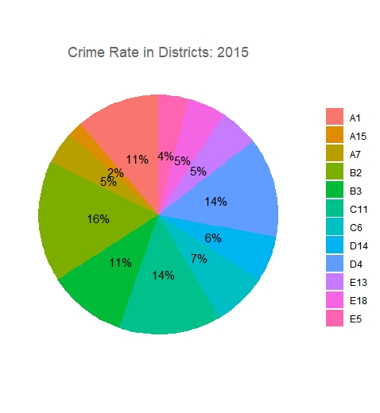
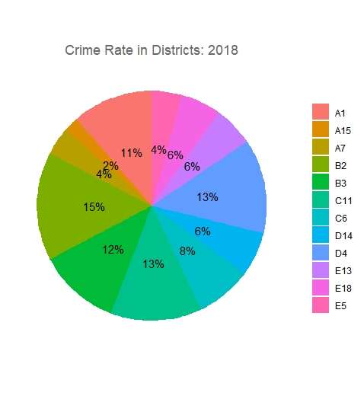
B2 : The Unwelcoming District
Year over year, B2 continues to be the District with most incidents reported
B3 & C11, not far behind

Slide 6
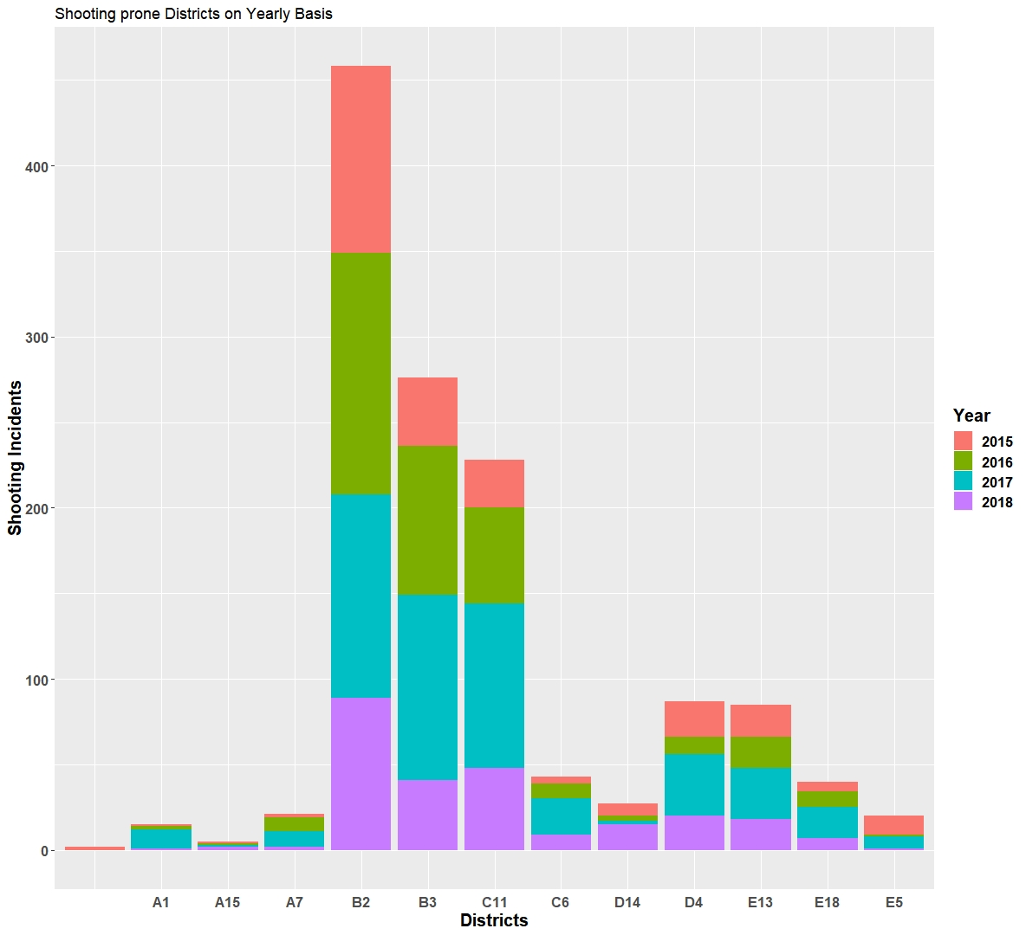
Beware of B2
Highest number of shootings in a district
500+ incidents over 4 years

Slide 7
Dangerous Nights
Nights, more prone to shootings
Avoid 8pm till 3am, particularly “Midnights”

Slide 8
Safer Downtown
Rare shooting incidents in downtown
Negligible shooting incidents around Northeastern University ( I will still stay in Seattle ☺ )

Slide 9
References:-
https://developers.google.com/identity/protocols/OAuth2
http://sape.inf.usi.ch/quick-reference/ggplot2/colour
http://www.sthda.com/english/wiki/ggplot2-colors-how-to-change-colors-automatically-and-manually#change-colors-by-groups
https://github.com/karthik/wesanderson
https://stackoverflow.com/questions/41338757/adding-percentage-labels-on-pie-chart-in-r
https://stackoverflow.com/questions/47238098/plotting-pie-charts-in-ggplot2
https://stackoverflow.com/questions/21588565/geom-bar-with-multiple-fill-colour-in-ggplot2
https://stackoverflow.com/questions/44988682/scatterplot-error-in-funxi-object-group-not-found
https://stackoverflow.com/questions/12328056/how-do-i-delete-rows-in-a-data-frame
https://stackoverflow.com/questions/35090883/remove-all-of-x-axis-labels-in-ggplot
https://ggplot2.tidyverse.org/reference/labs.html
http://www.sthda.com/english/wiki/ggplot2-colors-how-to-change-colors-automatically-and-manually
https://stackoverflow.com/questions/47238098/plotting-pie-charts-in-ggplot2
http://www.sthda.com/english/wiki/ggplot2-pie-chart-quick-start-guide-r-software-and-data-visualization
https://stackoverflow.com/questions/53275443/unable-to-use-register-google-in-r
https://stackoverflow.com/questions/45922418/error-in-install-packages-cannot-remove-prior-installation-of-package-dbi?rq=1
https://www.rdocumentation.org/packages/installr/versions/0.21.0/topics/uninstall.packages
https://community.rstudio.com/t/how-to-add-my-api-key-into-get-map/15992/4
https://stackoverflow.com/questions/53466051/applying-coordinates-points-on-google-map-using-r
https://stackoverflow.com/questions/8169323/r-concatenate-two-dataframes
https://blog.exploratory.io/merging-two-data-frames-with-union-or-bind-rows-a55e79766d0
https://stackoverflow.com/questions/15130497/changing-ggplot-factor-colors
https://www.rdocumentation.org/packages/imguR/versions/0.1.5/topics/dev.off
https://stackoverflow.com/questions/13297995/changing-font-size-and-direction-of-axes-text-in-ggplot2
https://stackoverflow.com/questions/25061822/ggplot-geom-text-font-size-control/25062509
https://stackoverflow.com/questions/38907514/saving-a-high-resolution-image-in-r
https://stackoverflow.com/questions/14794599/how-to-change-line-width-in-ggplot
https://stackoverflow.com/questions/23130604/plot-coordinates-on-map
https://stackoverflow.com/questions/53275443/unable-to-use-register-google-in-r
https://stackoverflow.com/questions/45922418/error-in-install-packages-cannot-remove-prior-installation-of-package-dbi?rq=1
https://www.rdocumentation.org/packages/installr/versions/0.21.0/topics/uninstall.packages
https://community.rstudio.com/t/how-to-add-my-api-key-into-get-map/15992/4
https://stackoverflow.com/questions/41886612/how-do-i-make-each-geom-point-into-a-different-color-based-on-how-it-is-classifi
https://stackoverflow.com/questions/41886612/how-do-i-make-each-geom-point-into-a-different-color-based-on-how-it-is-classifi

